Slide 1
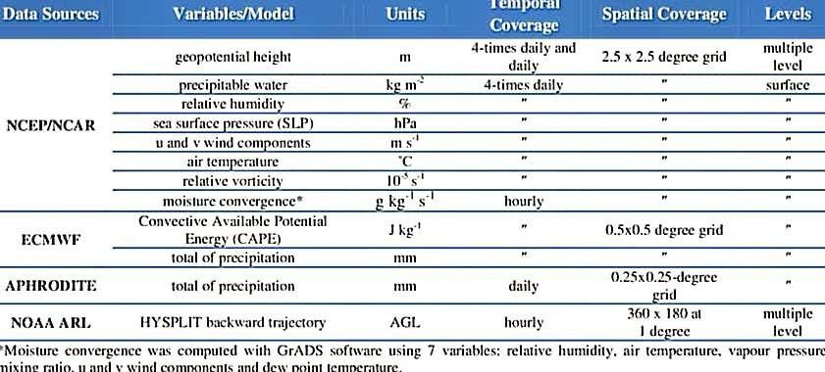
Date | 10 November 2022
Team Id | PNT2022TMID48907
Project Name | Natural Disaster Intensity Analysis andClassification Using AI
CYLONE

Slide 2
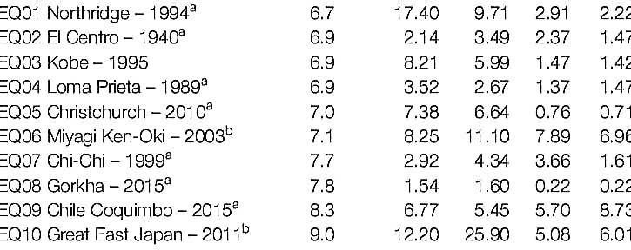
EARTH QUAKE

Slide 3
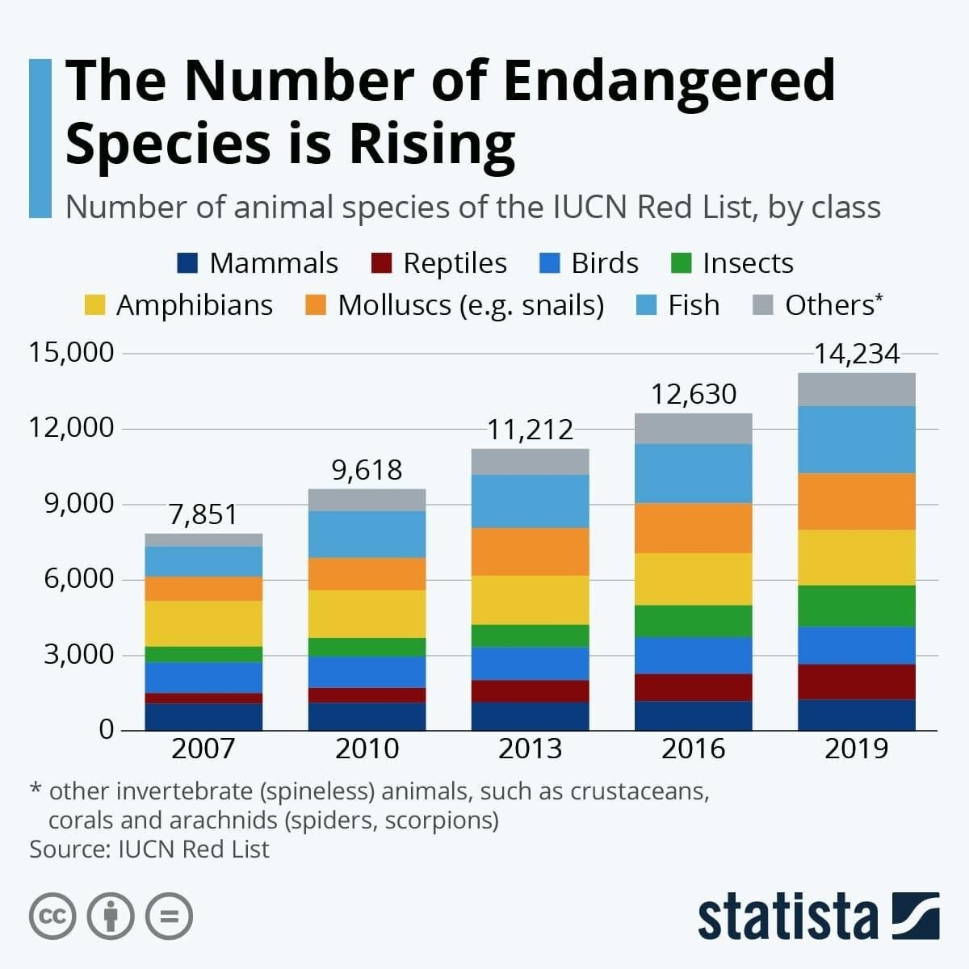
WILDLIFE

Slide 4
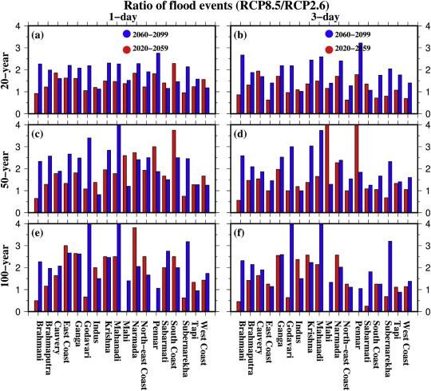
FLOOD

